Slide 1
SSWD – Project Presentation
GROUP NAME
Christian Gariando, Juraj Jarmek, Nhan Nguyen

Slide 2

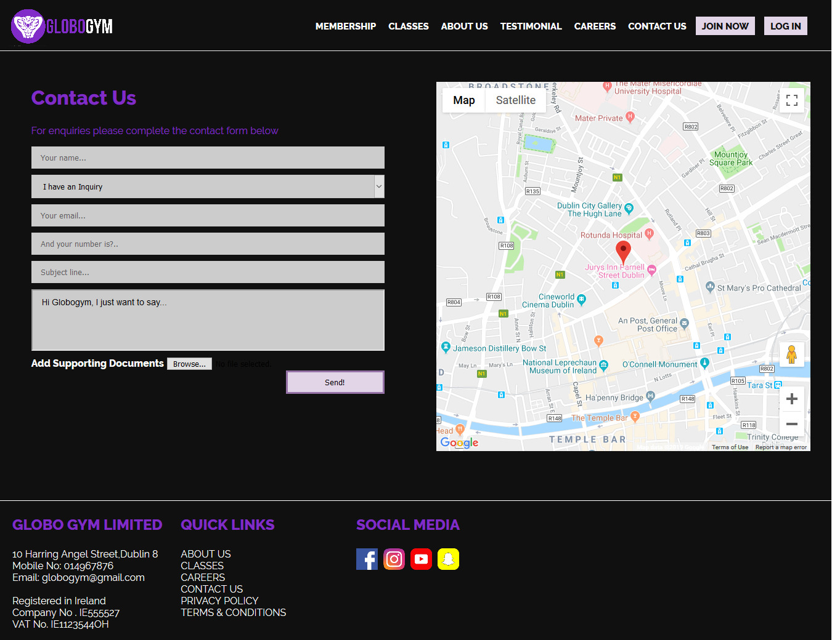
Visual Design - Index and Contacts page

Slide 3
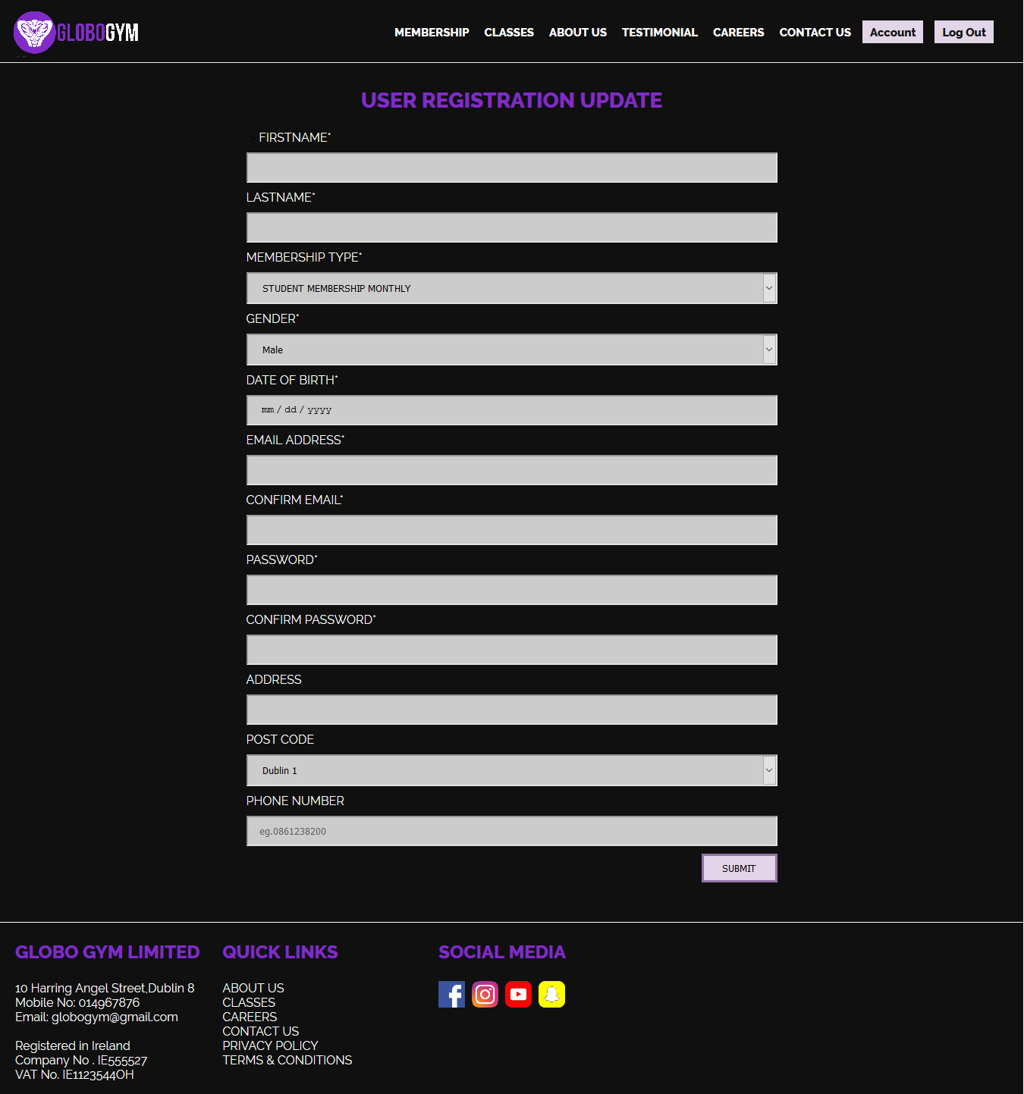
Private Section - Member

Slide 4
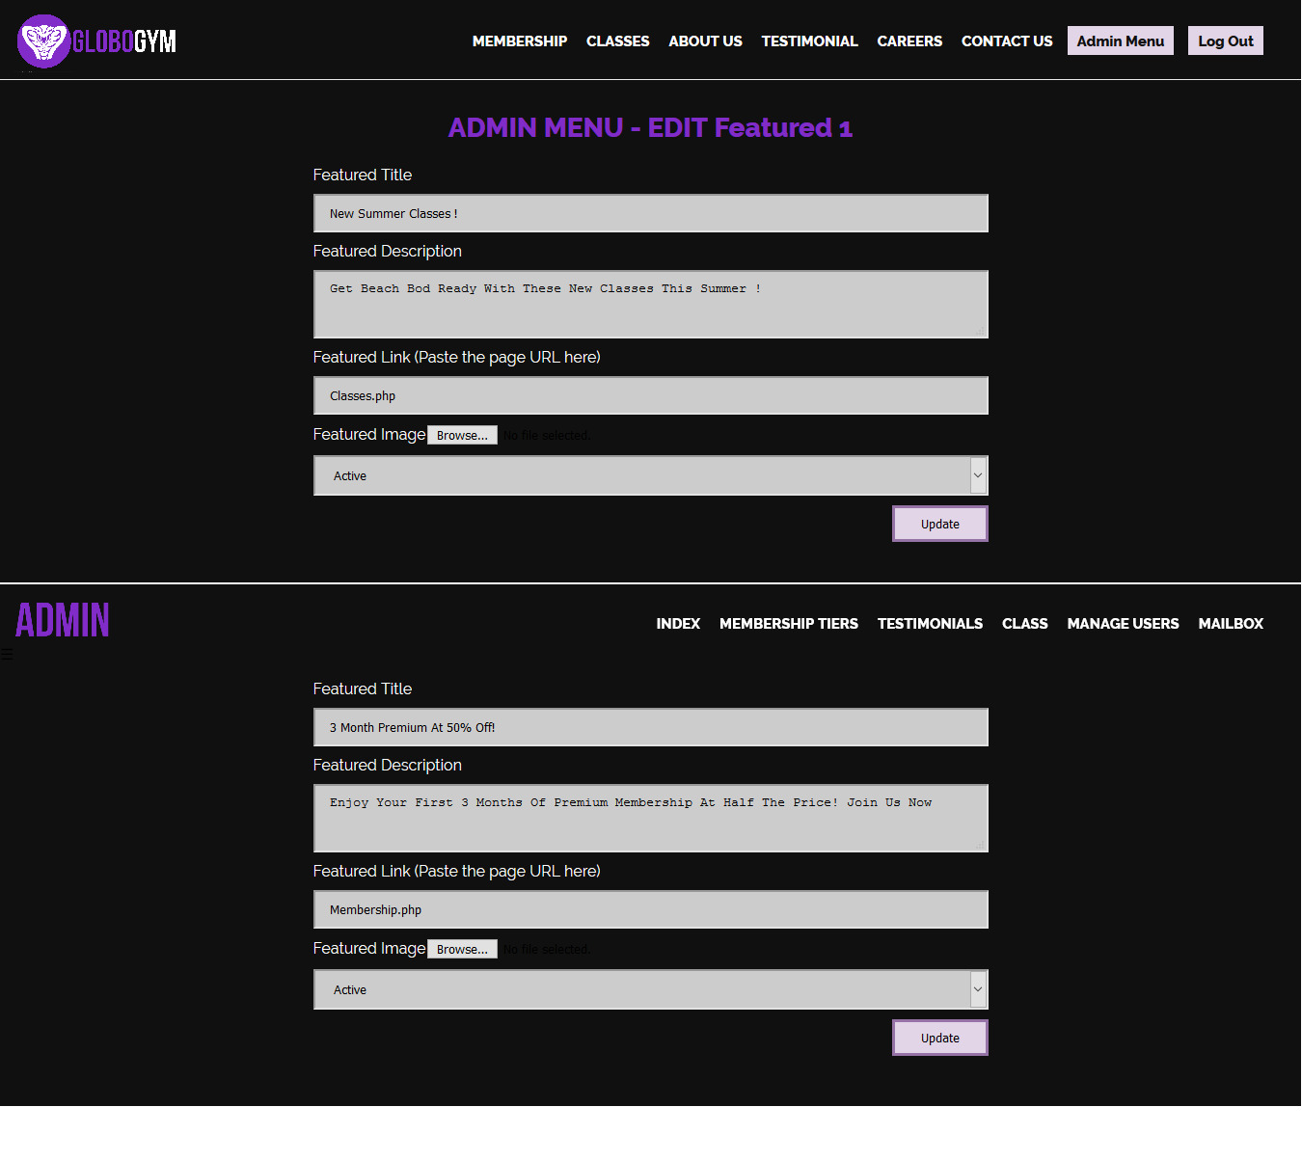
Private Section - Featured Content Admin

Slide 5
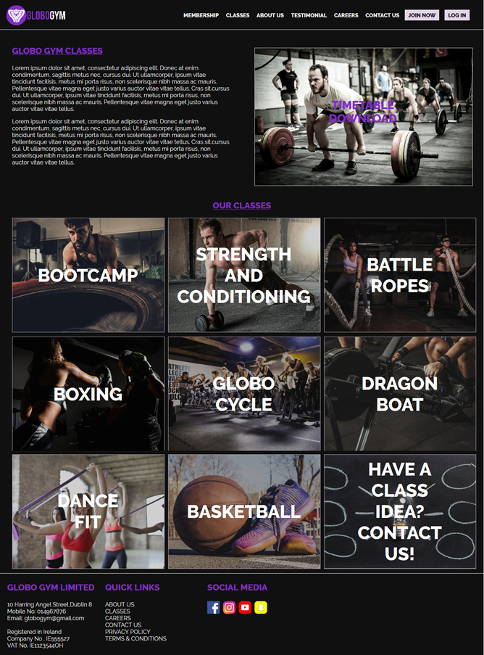
Classes page

Slide 6
Technologies Used
HTML5
CSS3
jQuery
JavaScript
PHP
MySQL
Google Maps API
C9
PHPMyAdmin
Visual Studio Code
Google Drive

Slide 7
Extra Feature(s)
We added an about section, careers page and Google Maps API
A careers page but was not properly implemented.
A page to edit the user’s details.

Slide 8
What is missing?
Unfortunately many sections were left missing from the code or left incomplete since we couldn’t complete due to time constraint.
All core modules are functional but bits and pieces such as error handling is not properly cared for.
Some of the extra pages have not been implemented.
Some frontend and backend validation.

Slide 9
Features to Improve
What would you like to add more into your application to make it even better?
Improved Contact Page
Improved Error Handling
Proper Implementation of the Careers Page
Proper Implementation of the edit user details
Images on the membership tiers
Payment system implementation
Receipts and Forms generation
More fluid UI
CMS implementation
User Logging

